Slide 1
SPA613M: Introduction to Celestial Observational Techniques
Prashant Pathak
Lecture 6
29/08/2024

Slide 2
Summary
Pinhole Setup
Magnification.
Field of View (FOV) dependence on focal length.
Simple telescope (refracting).
Plate scale of a telescope.
Energy density in the image plane.
Resolution of a telescope (diffraction).

Slide 3
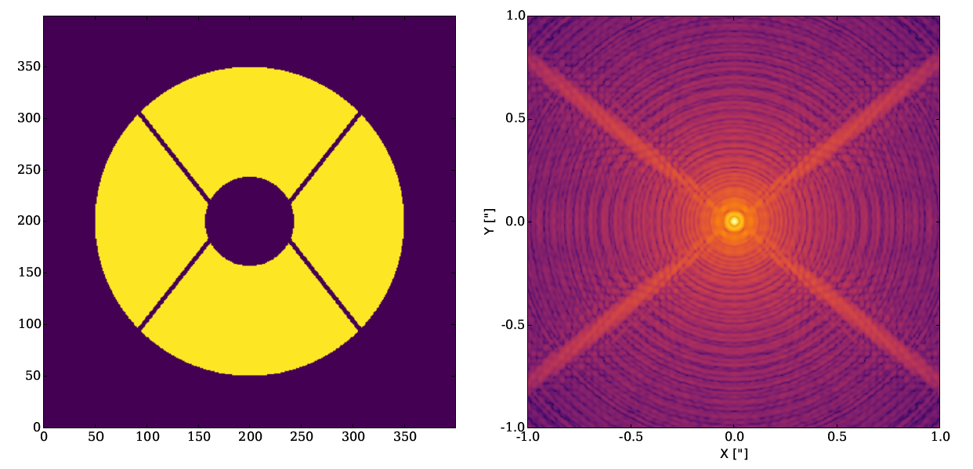
PSF of a typical Telescope
Subaru Telescope Pupil
8-m class telescope

Slide 4
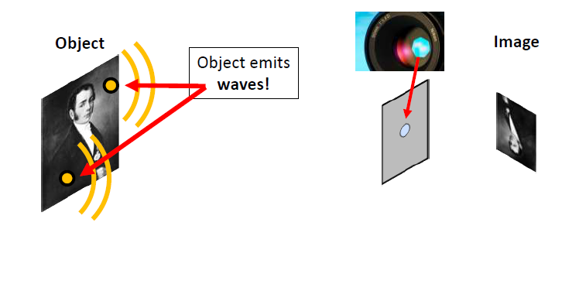
Image Formation (Isn’t just ray tracing)

Slide 5
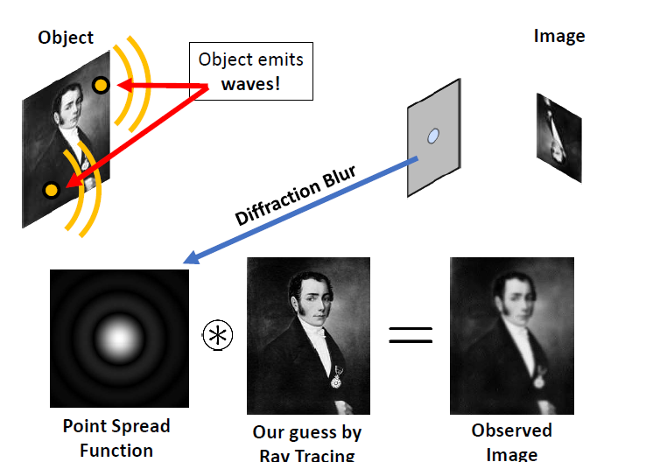
The Diffraction Limit

Slide 6
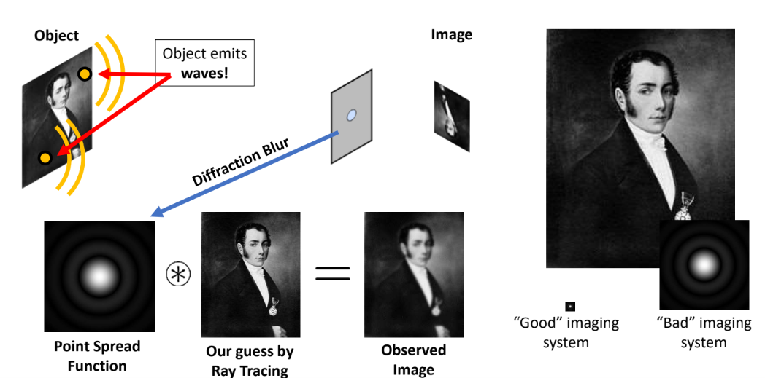

Slide 7
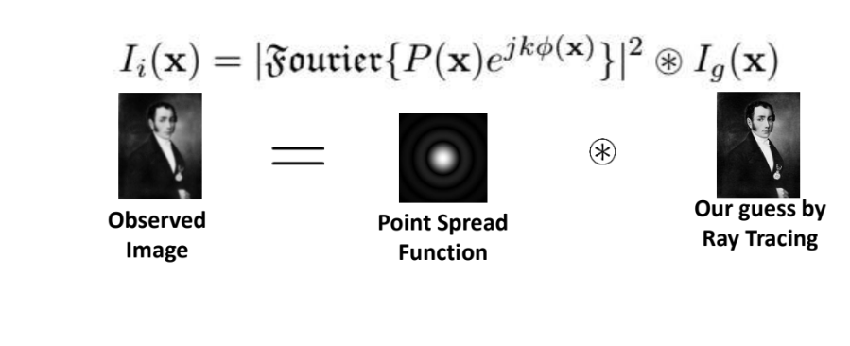
Fourier Transform of the Imaging Optics
Both Amplitude and Phase affects image formation
Example: our eye
Using lenses and mirrors provides better resolution and light collecting power.

Slide 8
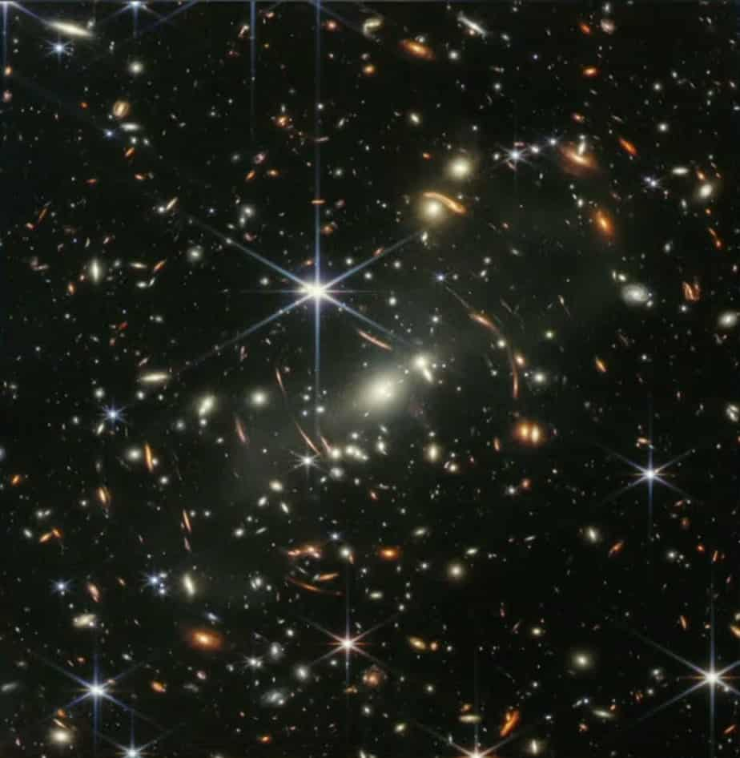
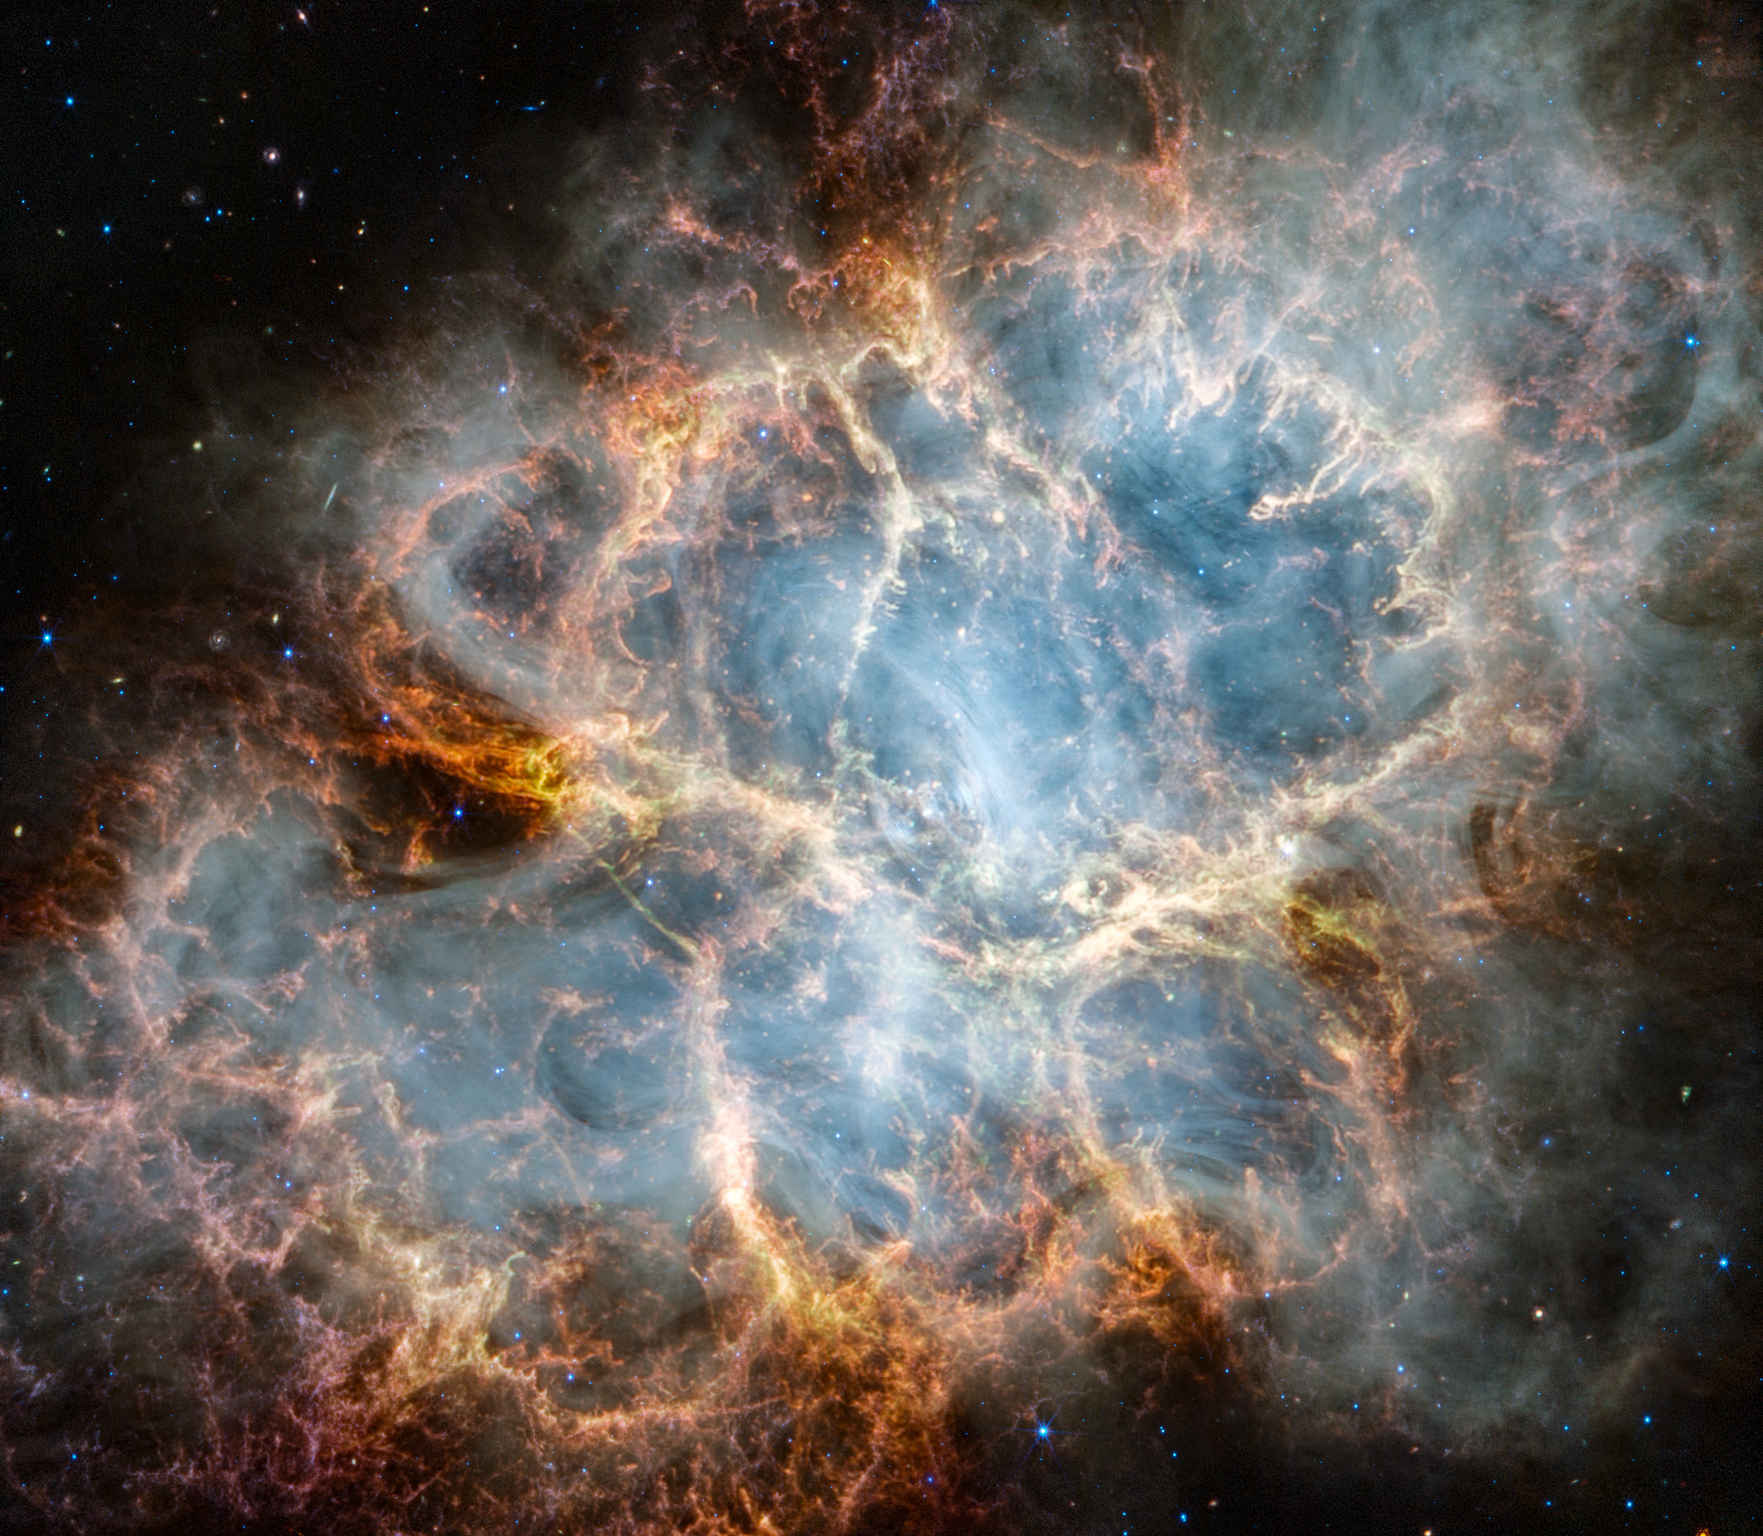
Images by James Webb Space Telescope

Slide 9
Aberrations
Chromatic (color or wavelength dependence on refractive index).
Monochromatic aberrations (Seidel):
Spherical aberration
Coma
Astigmatism
Field curvature
Image distortion
Deteriorate the image
Deform the image

Slide 10
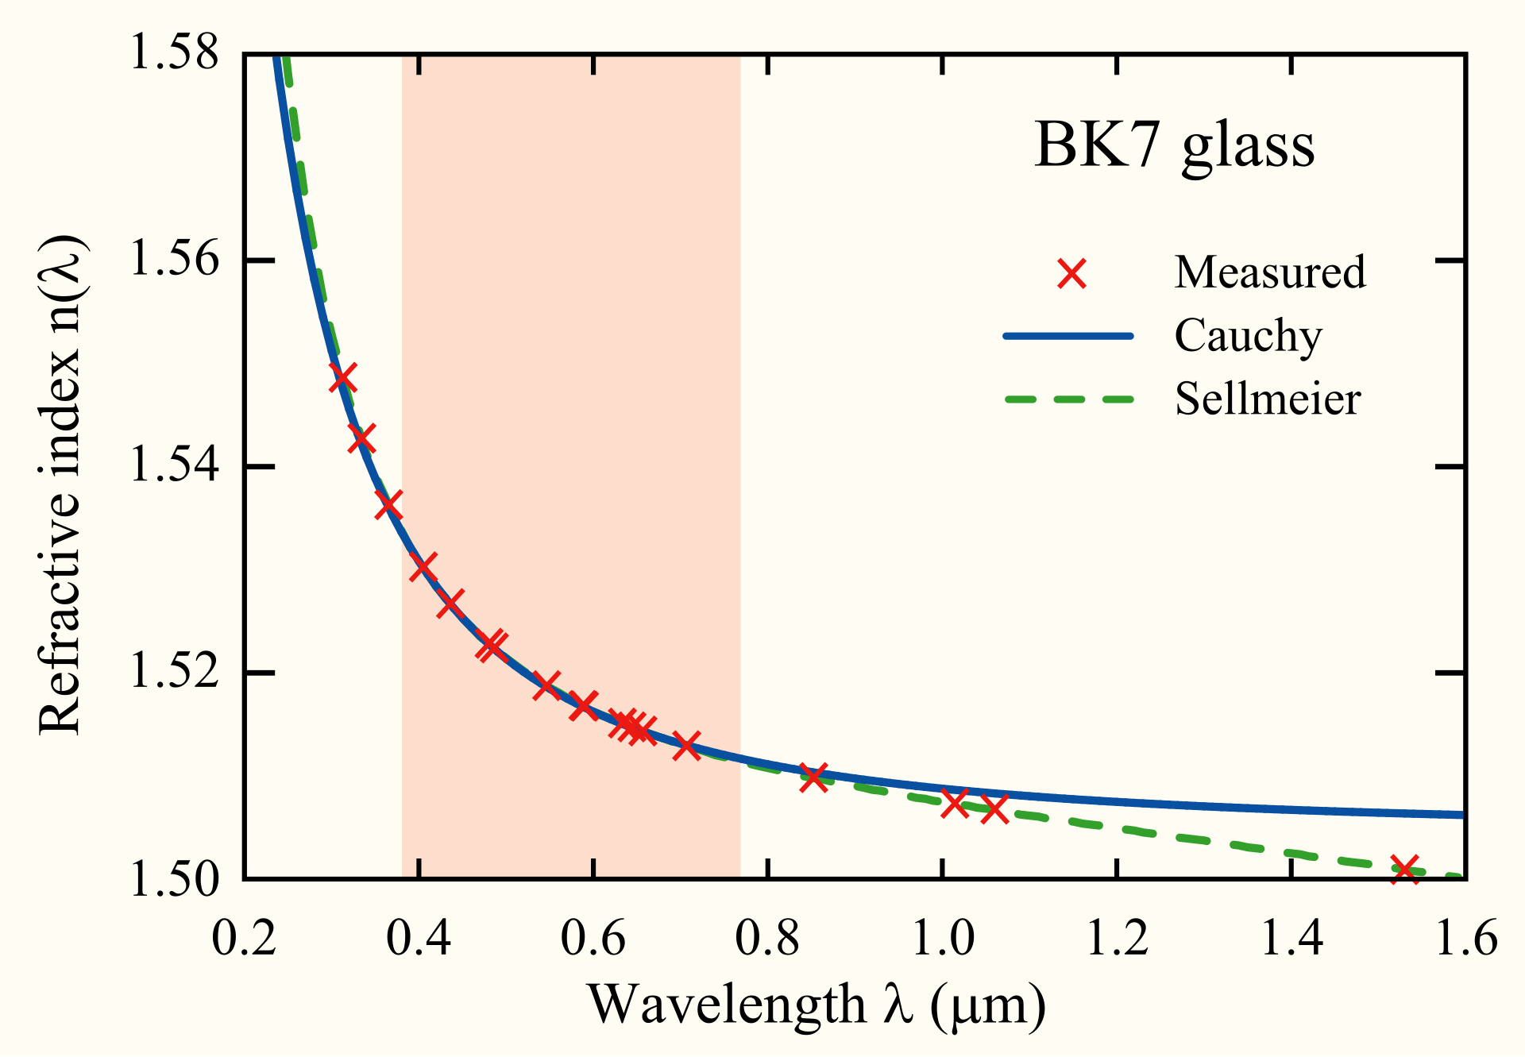
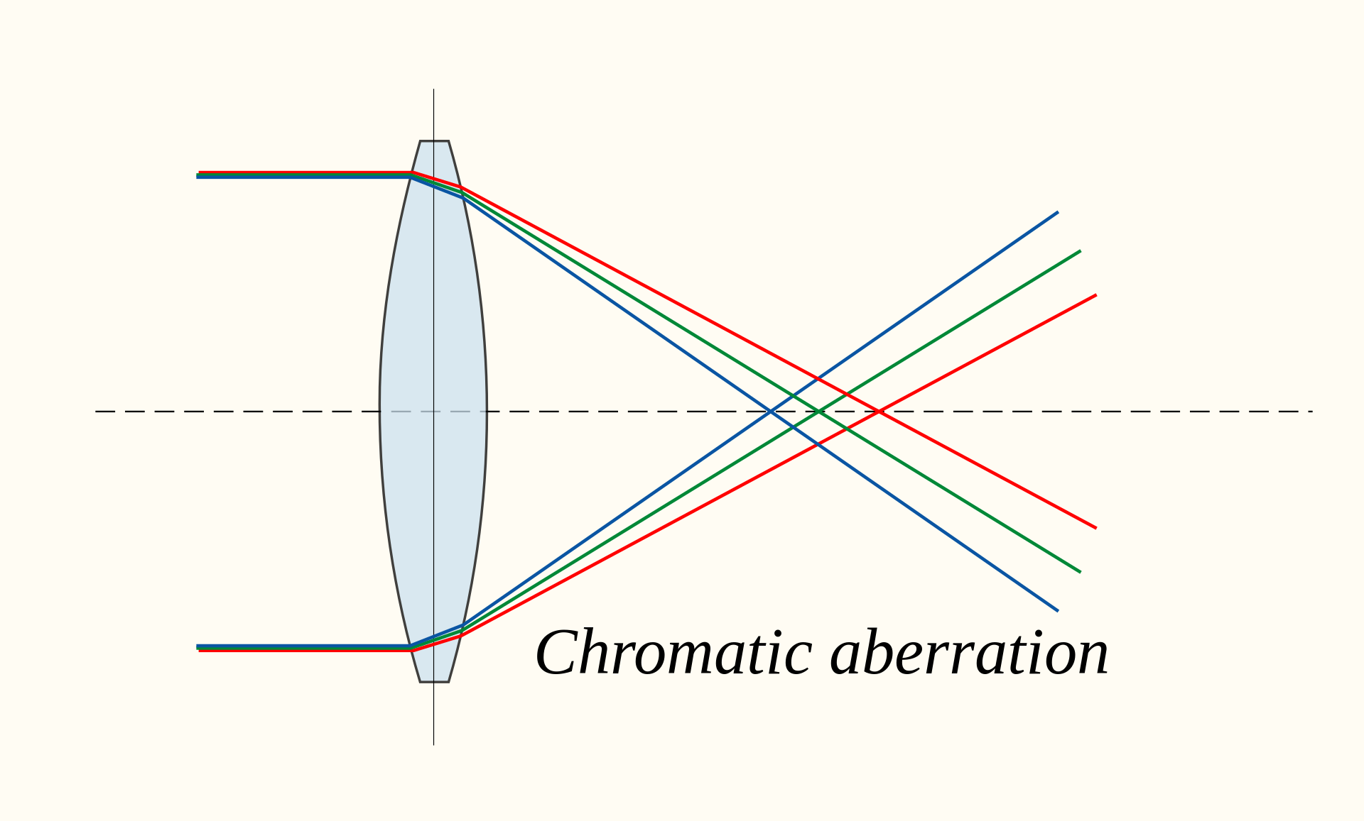
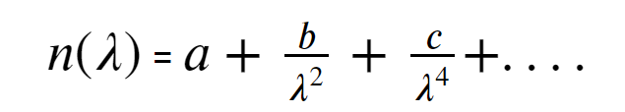
Chromatic Aberration
Glass Equation: Cauchy's transmission equation is an empirical relationship between the refractive index and wavelength of light for a particular transparent material.

Slide 11
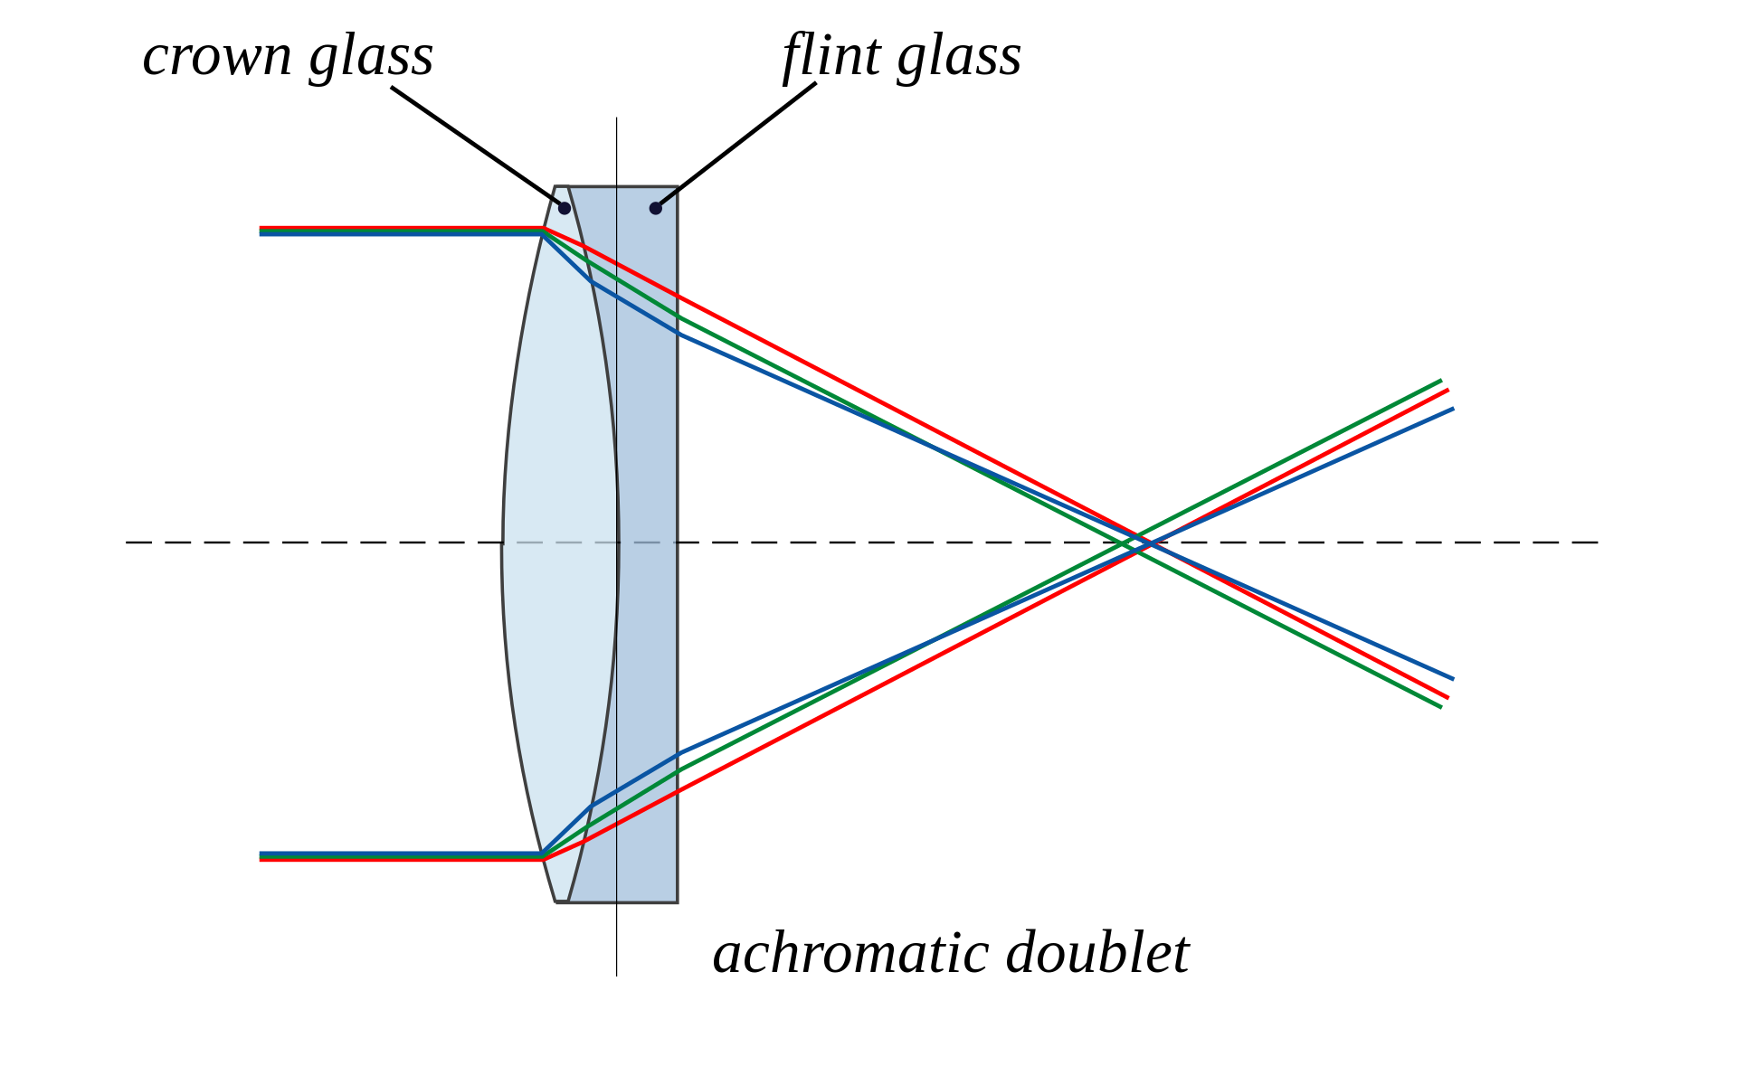
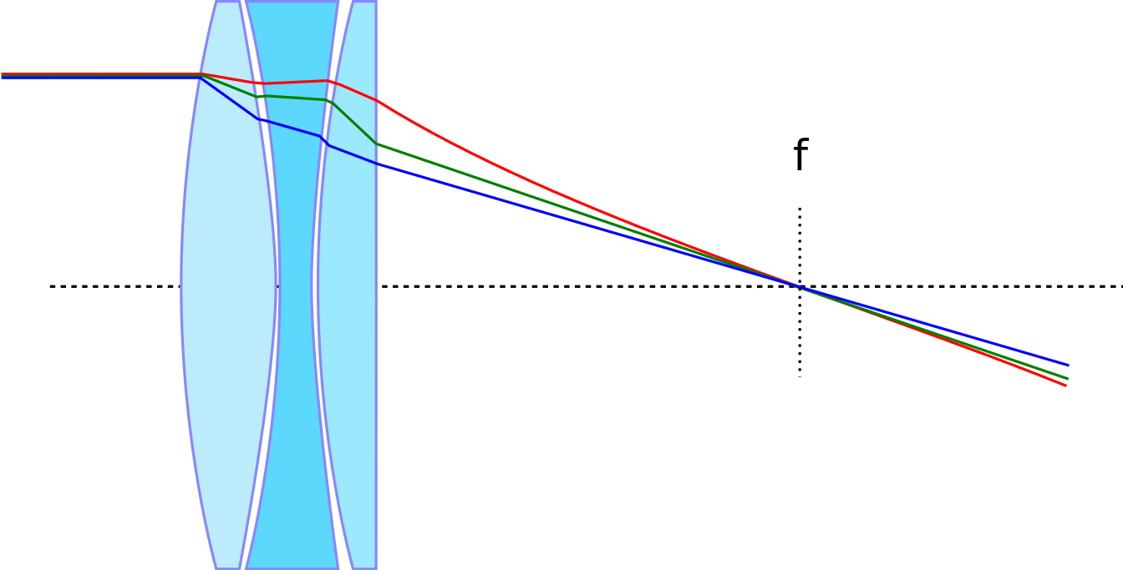
Chromatic Aberration
Peter Dolland: 1763
Refracting Optics.
Apochromat.
A properly designed triplet, called a superapochromat, can bring four different wave lengths to a common focus.

Slide 12
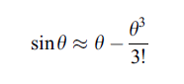
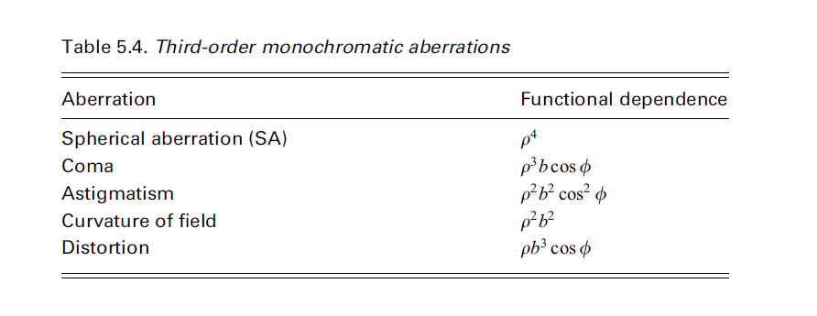
Monochromatic Aberrations

Slide 13
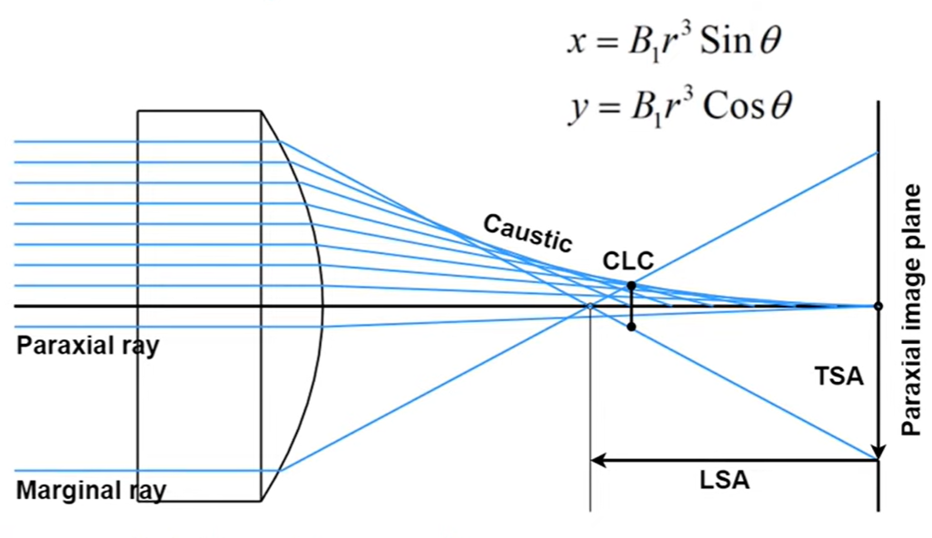
1. Spherical Aberrations
On-axis aberration.
Variation in focus with aperture.
CLC: circle of least confusion

Slide 14
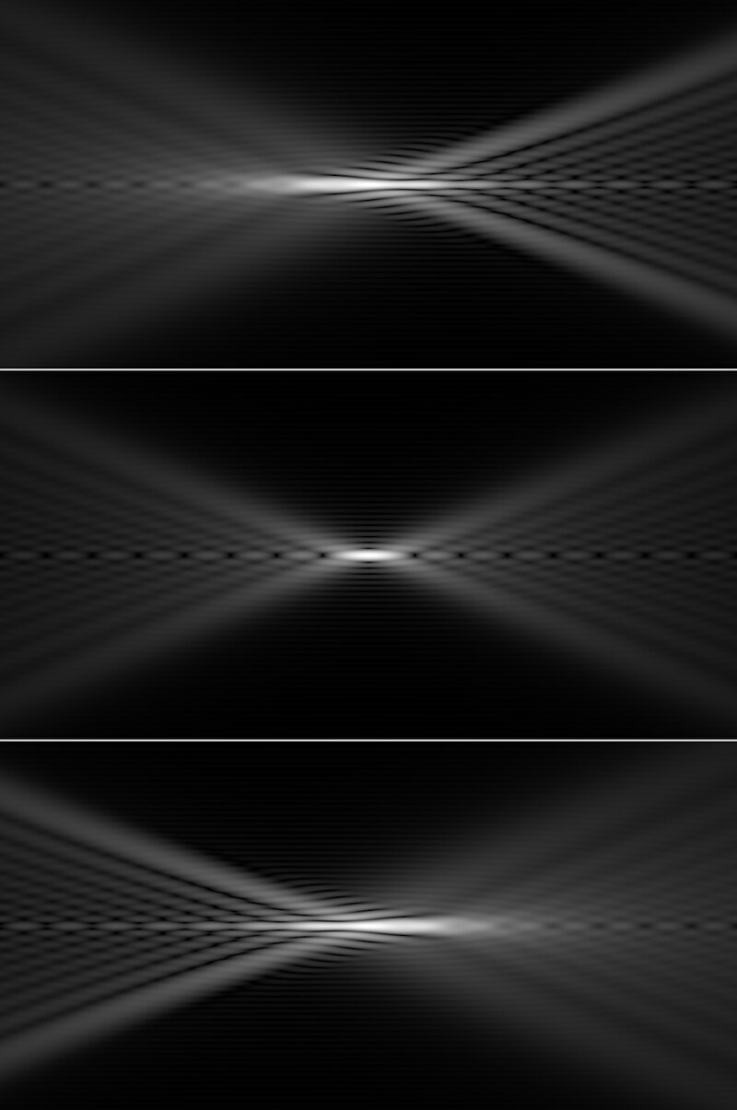

Slide 15
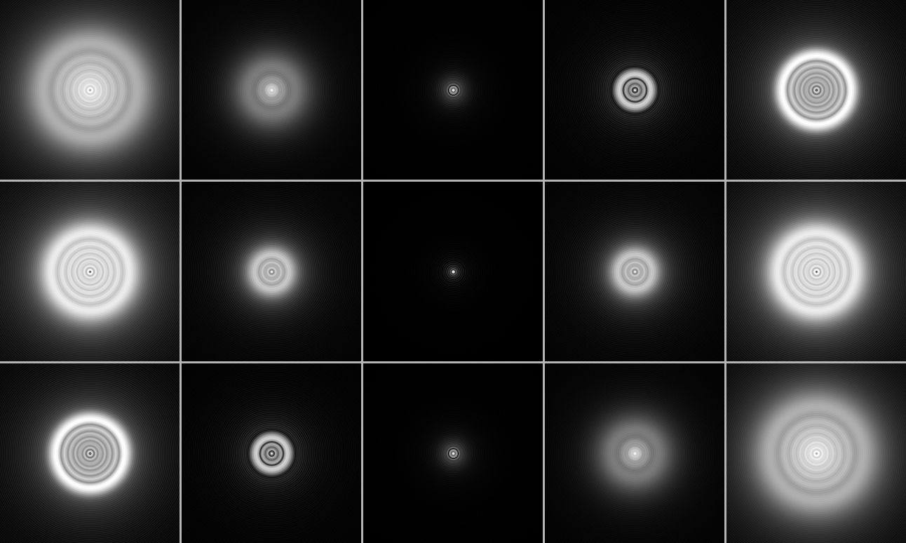
83%

Slide 16
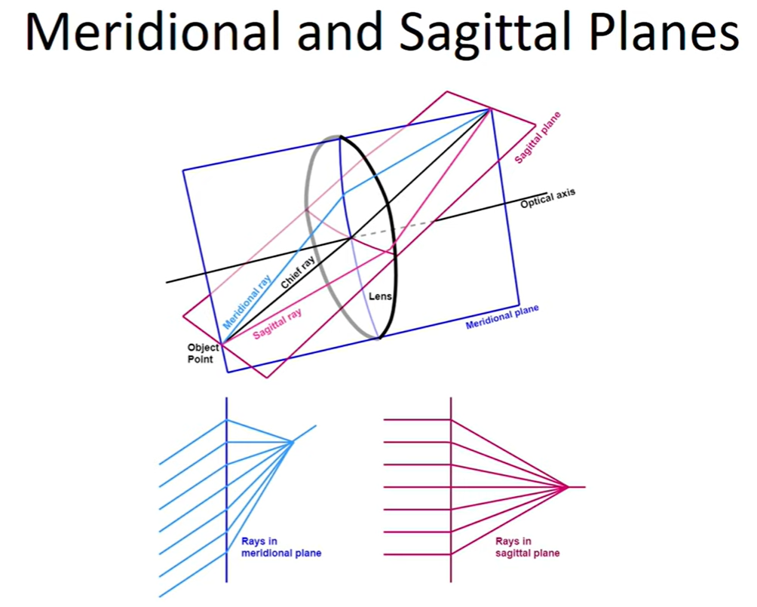
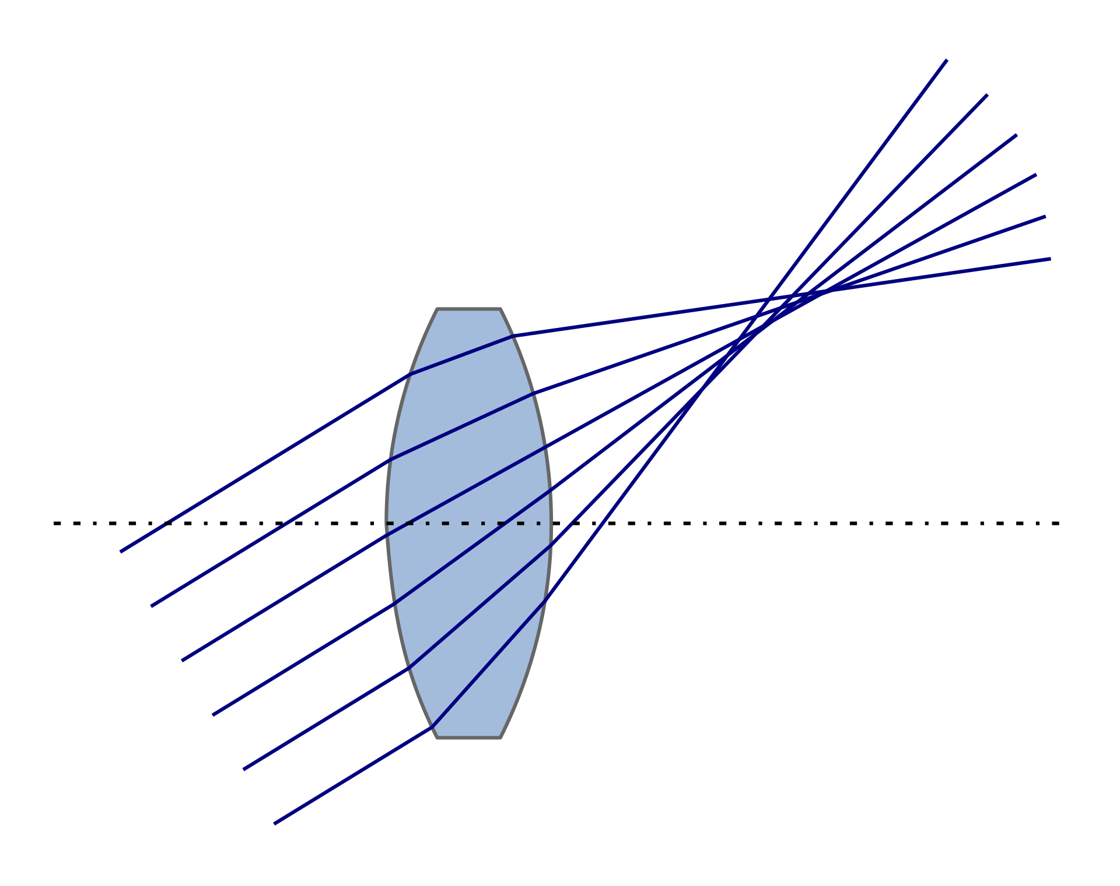
2. Coma
For off-axis source
Variation of magnification with aperture.
No longitudinal component, only transverse.

Slide 17
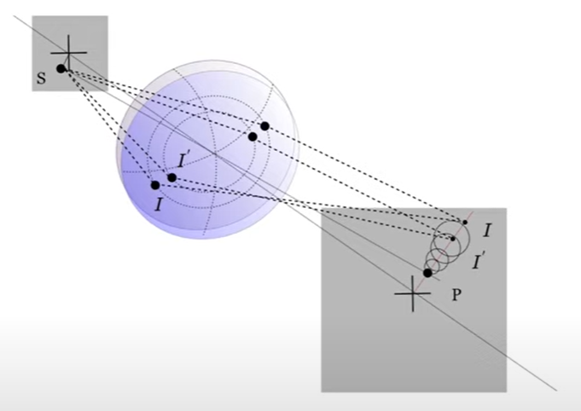
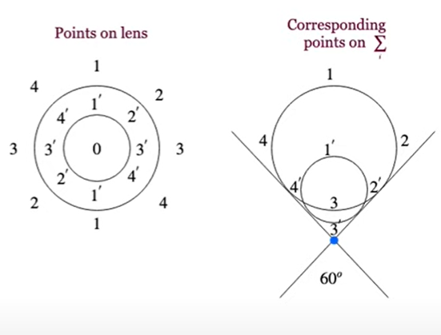
2. Coma
Coma: https://www.youtube.com/watch?v=EXmaY2txEBo

Slide 18
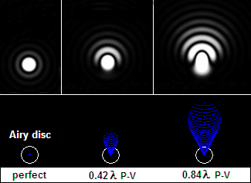
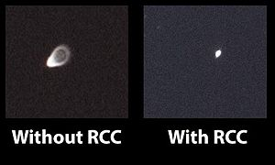
Coma Example
Example of an uncorrected f/3.9 Newtonian telescope vs the effects of coma with the Baader Rowe Coma Corrector. (Image Wikipedia)

Slide 19
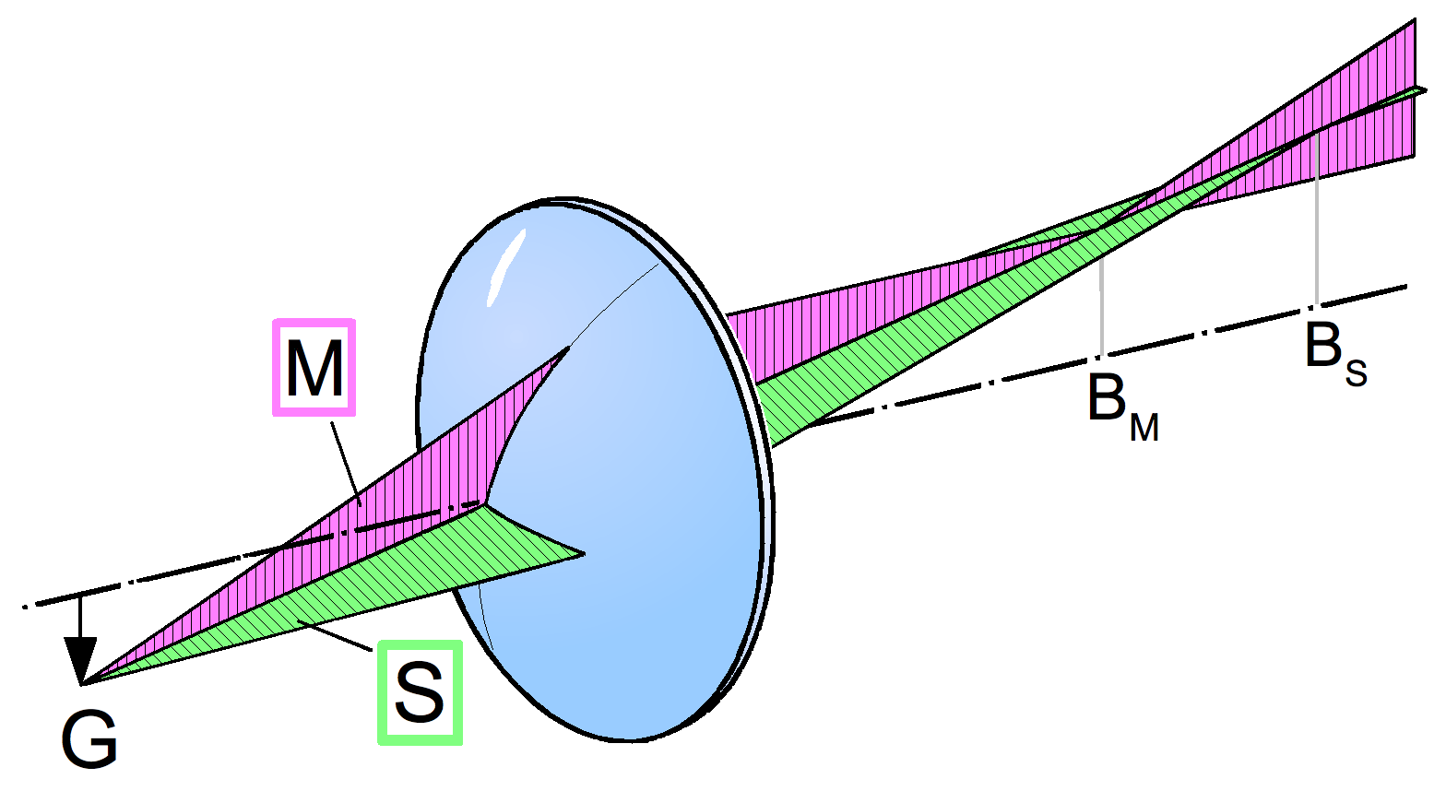
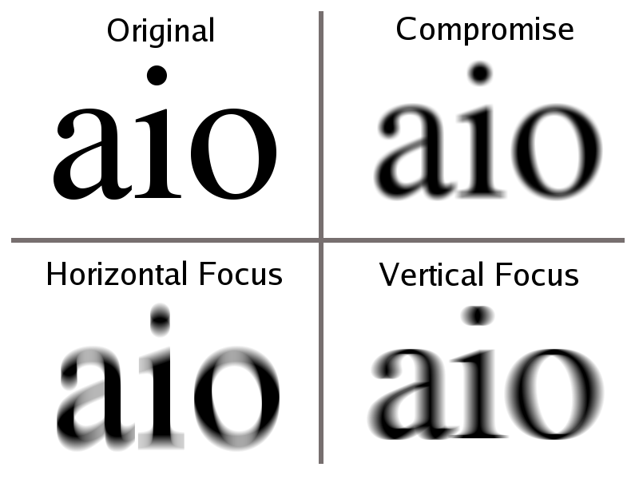
3. Astigmatism
If an optical system is not axisymmetric, either due to an error in the shape of the optical surfaces or due to misalignment of the components, astigmatism can occur even for on-axis object points.

Slide 20
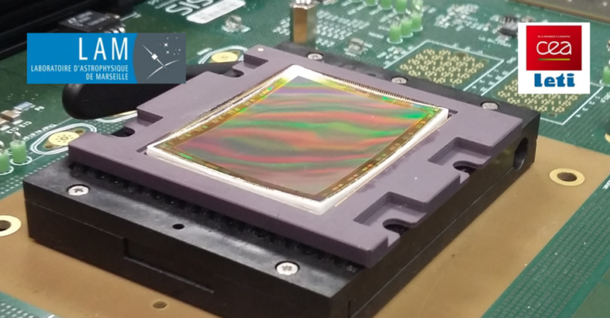
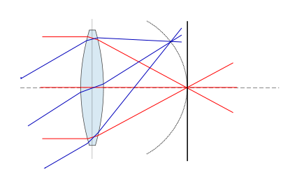
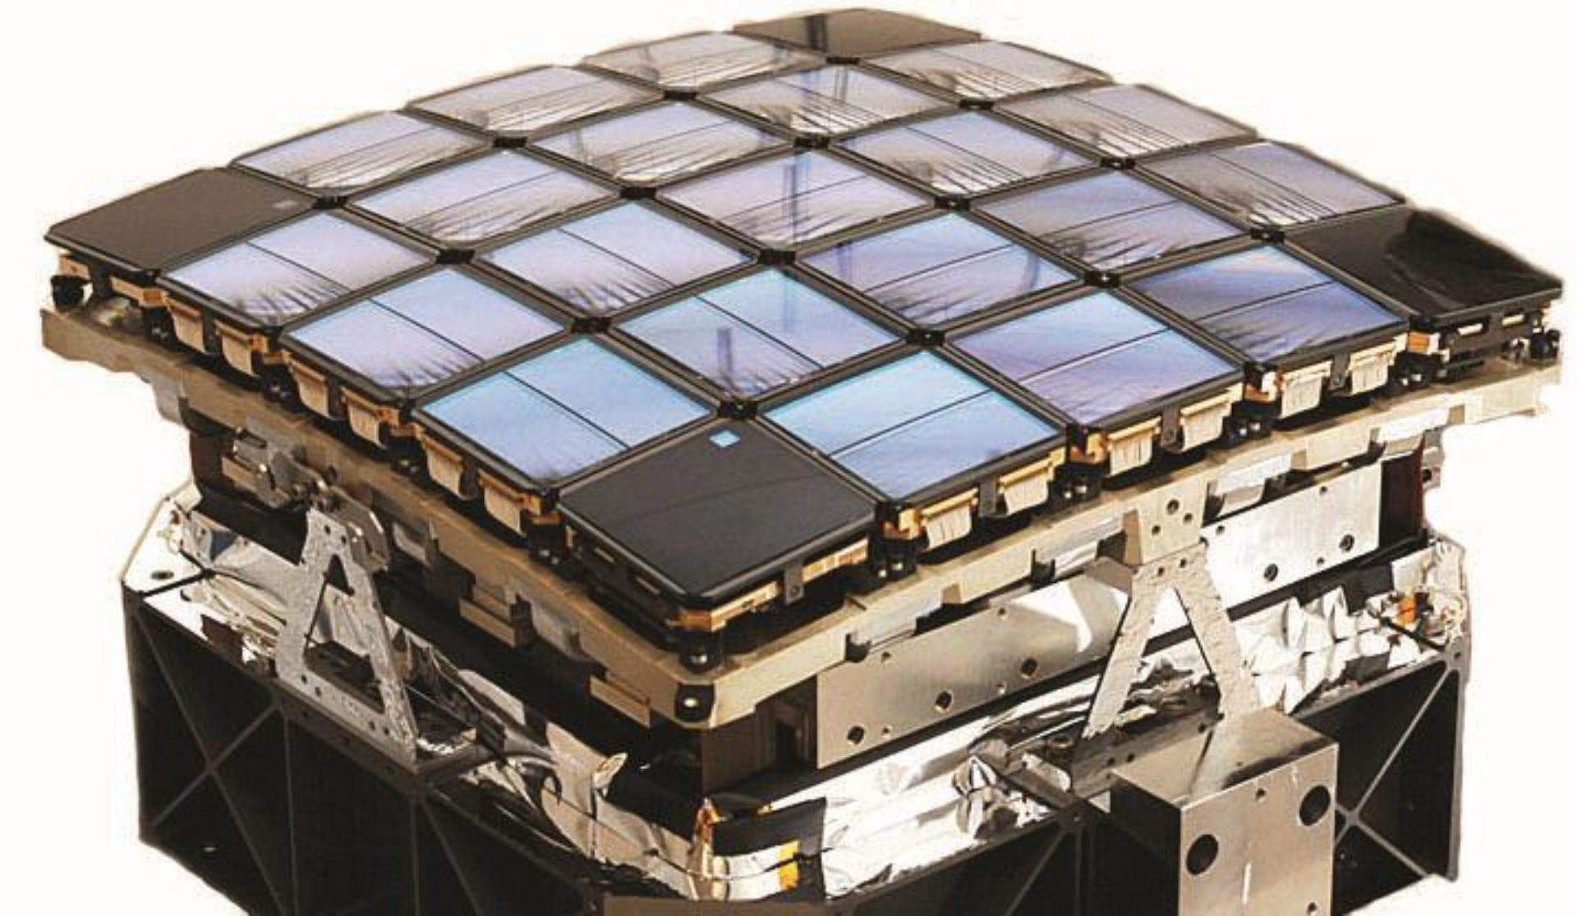
4. Field Curvature / Petzval field curvature
Focal surface is curved.
Depends only on powers of optical surfaces via the Petzval formula.

Slide 21
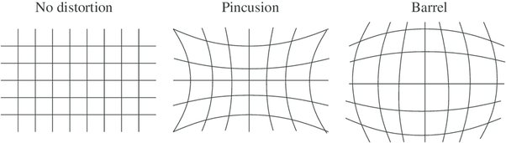
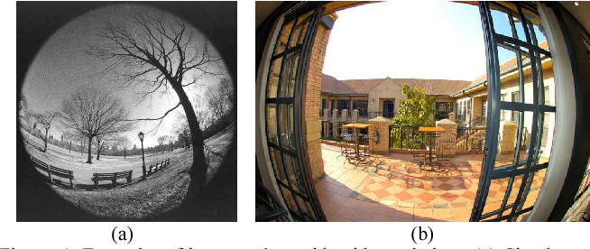
5. Distortion
Images are sharp but displaced from their correct positions.
Most dominant on wide angle lenses

Slide 22
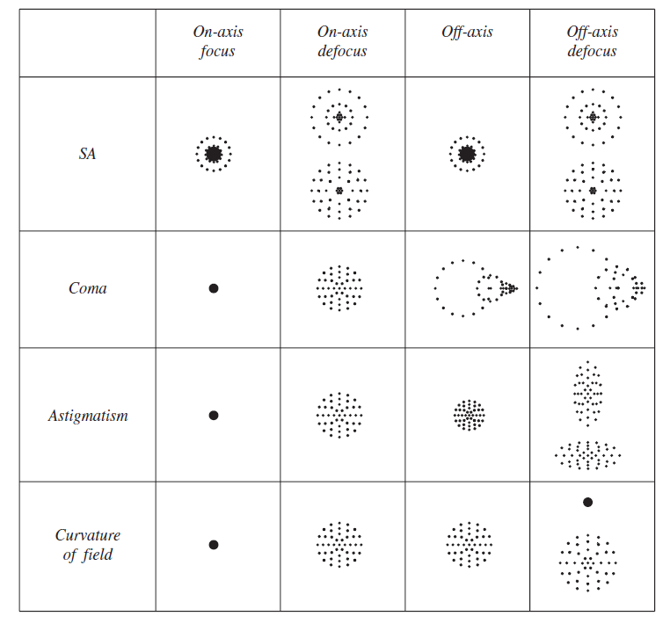

Slide 23
Keplerian Telescope (1611)
First description of spherical aberration and of the Keplerian telescope (objective and ocular both convex lenses).
Era of very long focal length refractors, constructed with single-lens objectives and limited by both chromatic aberration and SA. Large focal ratios minimize both aberrations (1612-1690).
https://javalab.org/en/refracting_telescope_en/

Slide 24
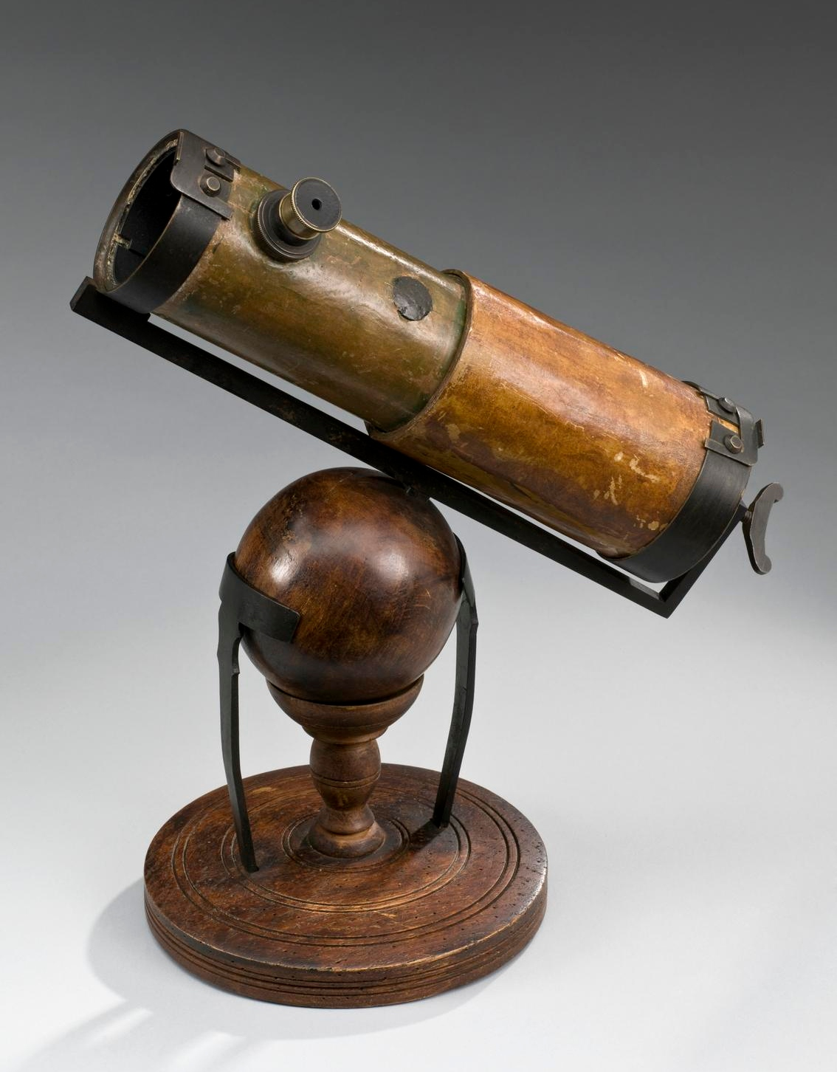
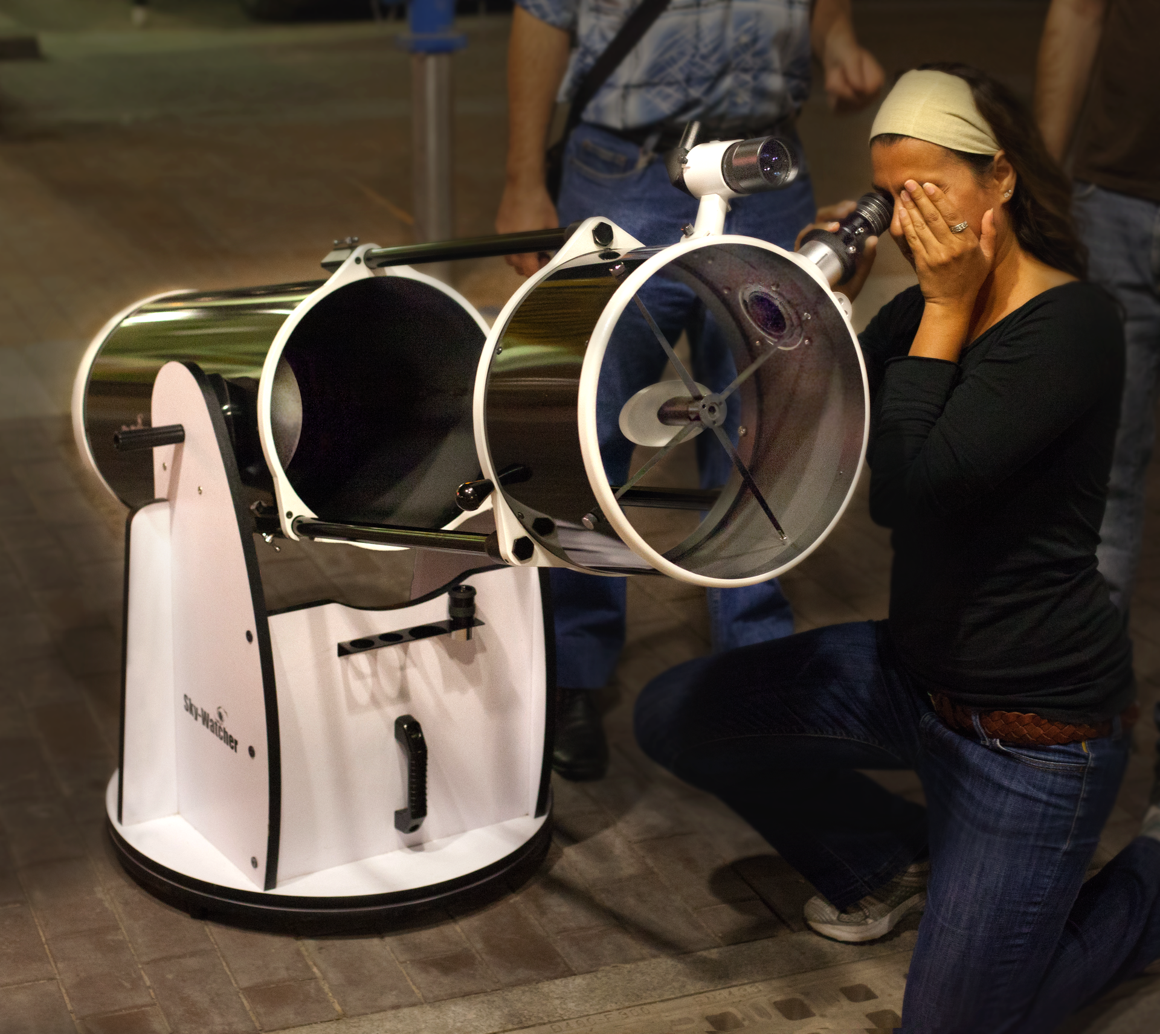
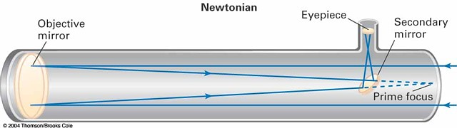
Newtonian Reflector 1672
Telescope based on spherical mirror (Speculum metal).
No chromatic aberrations.
Got inducted into the Royal Society for building the 1st reflecting telescope.
50 years later, parabolic mirror.

Slide 25
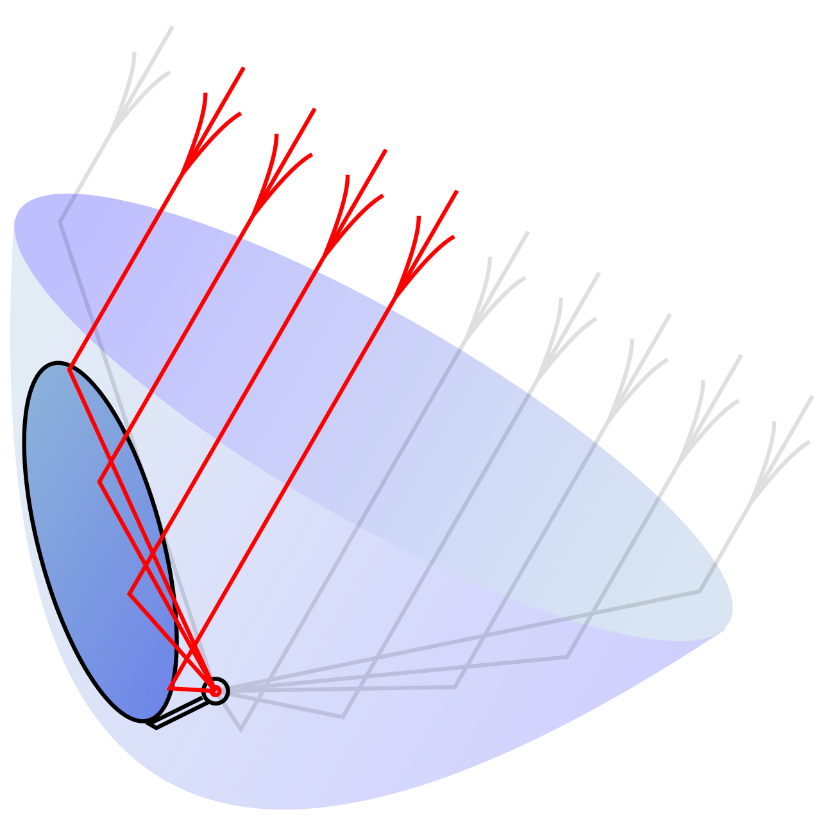
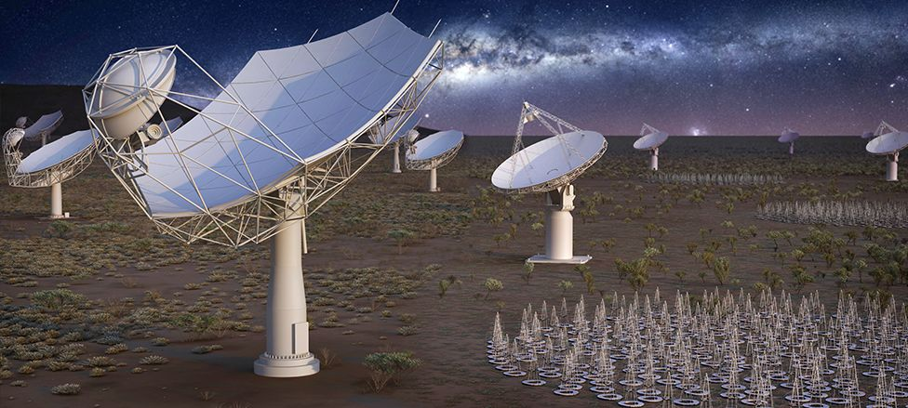
Parabolic Mirrors

Slide 26
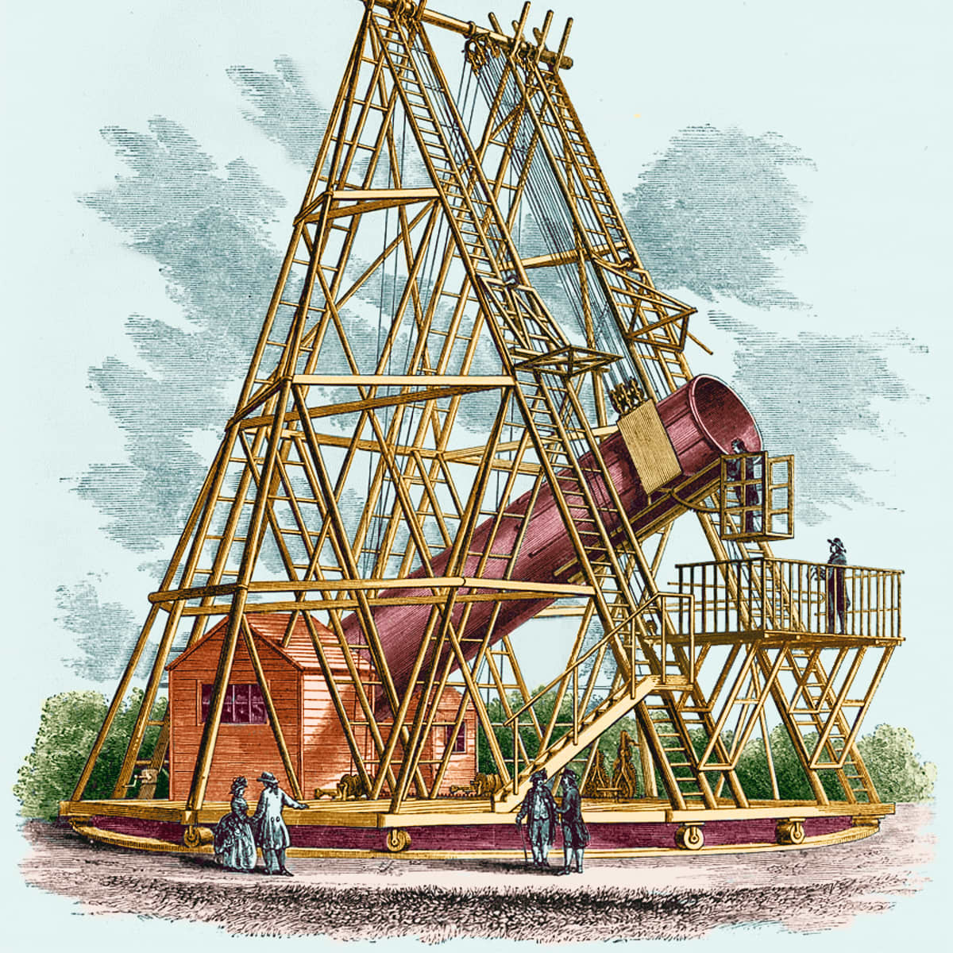
Large Newtonian Telescope
William Herschel, 1st parabolic Newtonian.
Collimation, tube flexure, support and tracking issues caused Newtonian to lose out to refractors when compared to achromats and apochromats.
Discovery of Uranus
13 March 1781

Slide 27
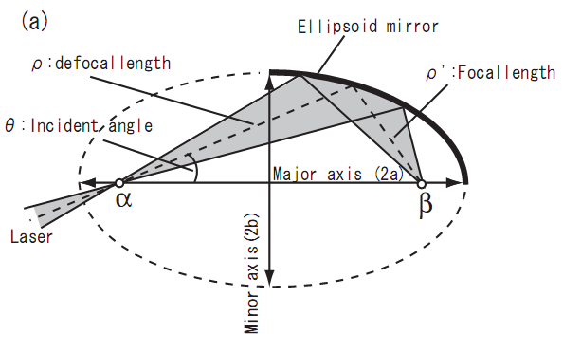
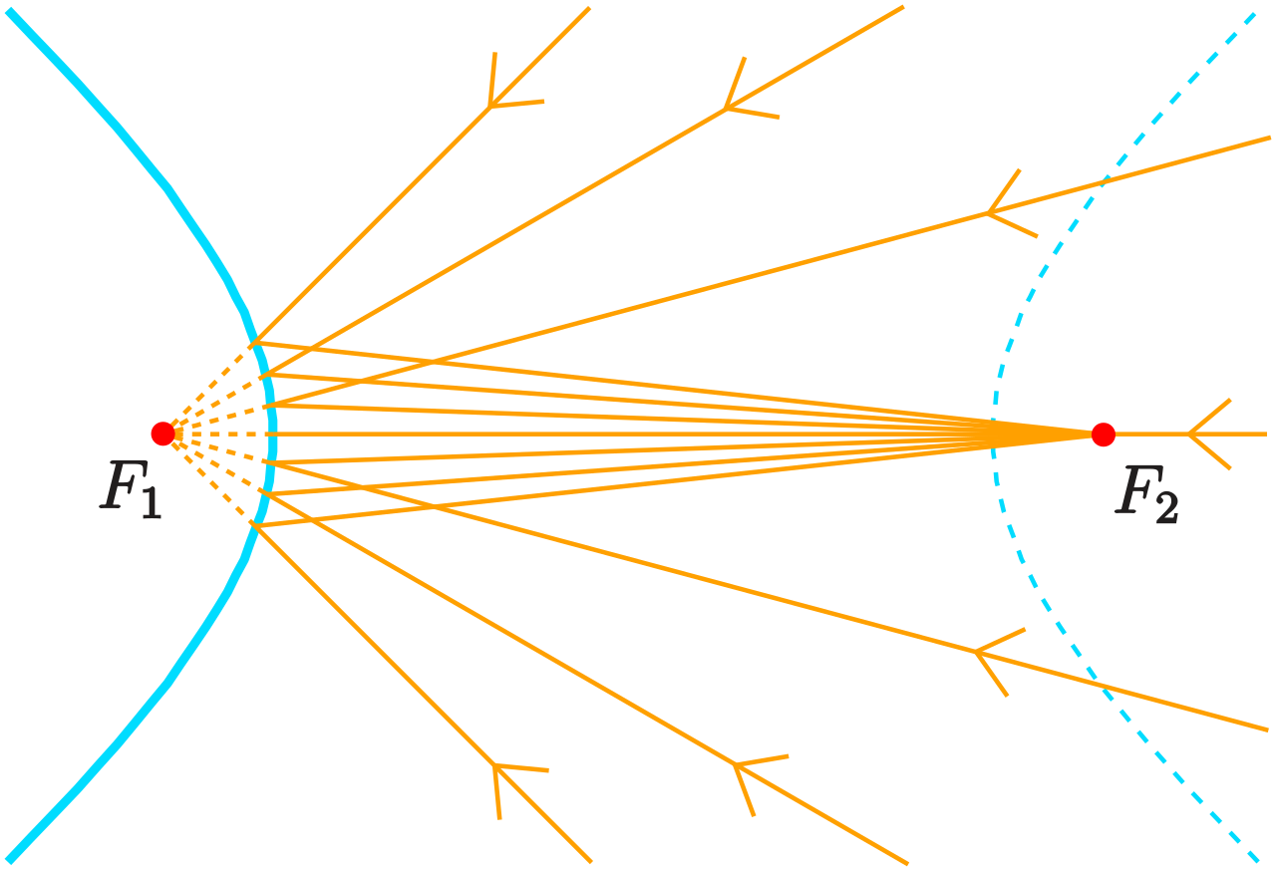
Hyperbolic & Ellipsoidal mirror

Slide 28
Cassegrain Telescope
Cassegrain: allows for higher focal length and higher magnification compared to Gregorian or Newtonian.
Gregorian – secondary is converging and is placed outside the focus
(a) Cassegrain and (b) Gregorian configurations

Slide 29
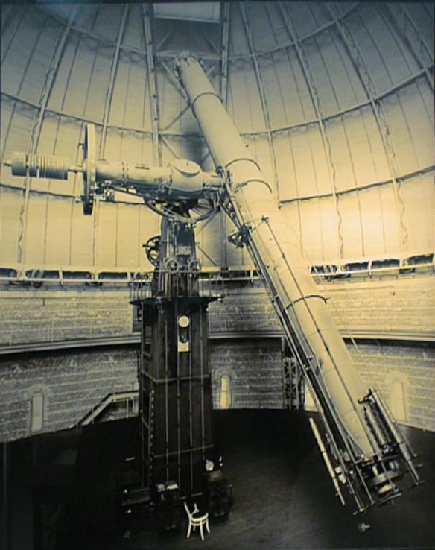
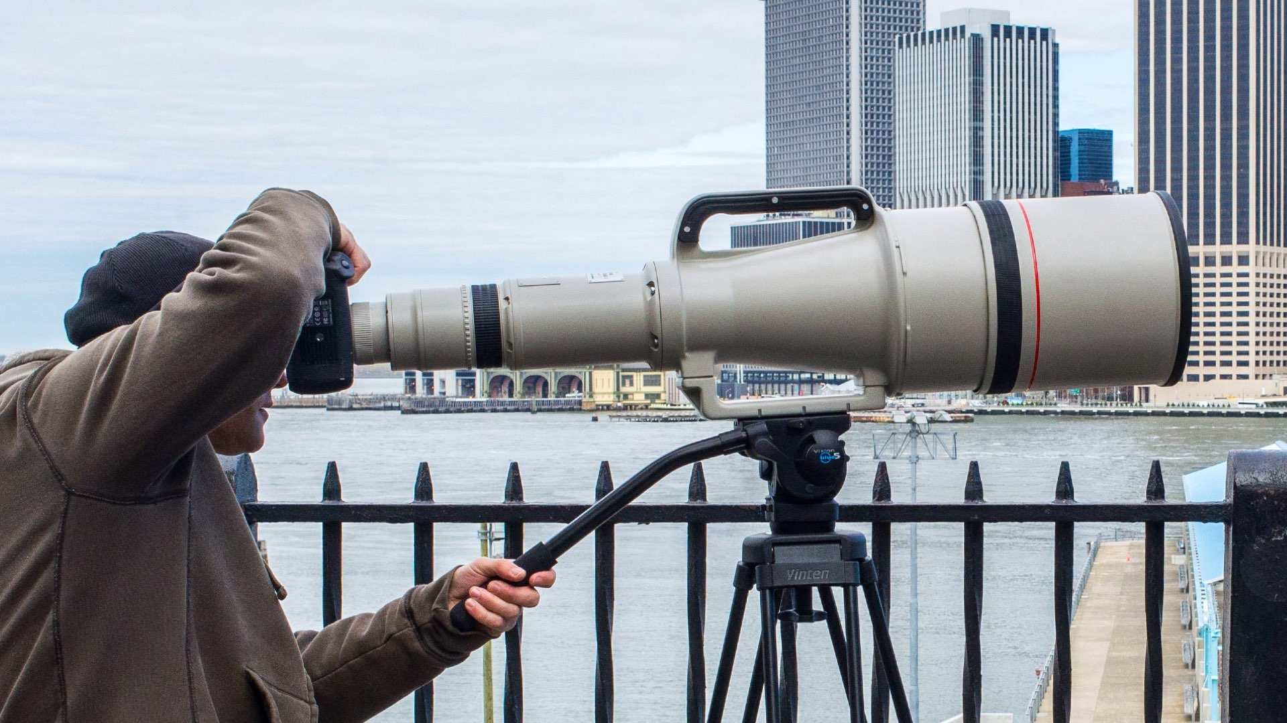
The largest achromatic refractor
Focal length ~19m
f/18.67
Gravity: weight of the glass even doublet
Large dome
Tube flexures
1-meter refractor, Yerkes Observatory, 1898, Wisconsin
1200mm f/5.6

Slide 30
20th Centaury
Cassegrain's and Newtonians were the most popular reflecting telescopes in the early 20th centaury.
Both used parabolic primary
Large focal ratios were employed to minimize coma.

